Slide 1
STuFun
Android Application for Mini Project

Slide 2
Project Supervisor : Mr. Vaibhav Diwan
Team Members
Jalanki Nayak
Kartik Agrawal
Tushar Gupta
Yash Vardhan

Slide 3
Project Index
Introduction and Motivation
Proposed Solution
Objective
Technology Platforms Overview
Application Feature Overview
Functional and non Functional Requirements
Software Design
Implementation
Application Snapshots
Conclusion

Slide 4
Introduction and motivation
In today’s world, there is hardly anyone who does not uses Chatting Application like WhatsApp, Hike etc. for connecting with their friends and family.
In these Applications we can do personal chats with a particular person or we can create chatting groups in which we can chat with with more than one people at a time.
Now a days these groups are also used for educational purposes like teachers can create groups of their class and can share information into these groups like notes, videos related to topics, and many more things. But using these groups for educational purposes has some limitations.
There are various cases like
Consider a situation where teachers want to conduct a quiz among their students, so they have to use an another platform for organizing the quiz and maintaining the record of each quiz. 2.
Consider another situation where teachers have given an assignment and provided a deadline of submission. If students submit their assignment in the same group then it will be quite difficult for teacher to manage the assignments. To avoid it, teacher will either provide his/her email id for assignment submission or use another platforms like Google Classroom for work related to assignments. 3.
Consider another situation where student is having some doubt regarding a topic and he/she want to discuss it with class. Normally students share their doubts in the group and a discussion starts on that topic. This type of discussion is considered as informal discussion and is not preferable in official groups.

Slide 5
Proposed Solution
Groups in these Chatting Applications should be used for informal chats and fun. Using these groups for educational purposes is not preferable and has many limitations. To overcome the limitations discussed above, an application need to be made which contains the features of both chatting application and classroom. This application would incorporate the following features which would overcome the limitations in groups of chatting application:
➢ A Chat portion whose functionality will be like WhatsApp chat. We can chat personally with anyone. We can also send photos, documents, links etc.. via chat.
➢ A Classroom portion which will work on the functionality of Google Classroom. User can create a class and each class will be having a unique id. User can also join a class just by entering the class id.
➢ If you have created a class, you will have the following privileges : • You can see the details of those members who have joined your class. • You can upload assignments with deadlines and can monitor the list of students who have submitted it. • You can upload a quiz which will start at the time given by you. Quiz can be assigned in two ways - ◦ Each question will have a time boundation. ◦ Overall time limit for Quiz. Real time monitoring will be there during quiz. • You can manage the students. You can either add a student or delete a student.
➢ If you have joined a class, you will have the following privileges - • You can see the list of assignments along with their deadlines. One can submit the assignments by clicking on it. • You can see the list of quiz allotted to you by your teacher along with their starting time. You can only attempt the quiz by clicking on it once it has been started by your teacher.
➢ Along with this, there will be a discussion panel which will be open for both teacher and students. It will be serving two purposes - • Student can ask their queries and whom so ever knows the answer can respond to that query. A list of query will be displayed in discussion panel from where student can view a query and it’s answer. • It can act as poll. Teacher can launch a poll in the form of question and student can vote in the form of answer.

Slide 6
Major objectives to achieve
The objective of this project is to create an android application within the given time limit. The android application to be created is named “StuFun”.
The primary application objective of this android app is to serve both as a chatting app and as a classroom app that focuses on the student and teacher side of the problem. The project must have begun by August 2020 and should be completed by the end of November 2020 as fully functional.
The educational objective of the project is that by the end of the project all team members would have learned about the basics of the android app development with a language of their choice.
As the app is a chat application it must have a functional chat infrastructure in two modes, viz a person to person mode and common group mode, the app should also be able to provide basic functionalities that everyday use apps like WhatsApp, Messenger, Hike provide.
On the part of the classroom, the objective is to create a classroom with a chat room/groups like infrastructure where students can interact with each other and their teachers on matters of their class and studies.
Another major objective of this app on the classroom side is to provide a platform for resource sharing where educational material can be provided to students time by time. As to make the classroom a strong tool for study and making the experience as real as possible we add another objective of creating a question panel in the classroom where it would be compulsory for the teacher to answer questions of the student.
Carrying forward this objective of making the learning environment as real as possible the team would also be adding a feature of real-time quiz where students can give academic quizzes provided by their teachers.

Slide 7
Technology platform overview
Java
XML
Java is a general-purpose programming language that is class-based, object-oriented, and designed to have as few implementation dependencies as possible. It is intended to let application developers write once, run anywhere (WORA), meaning that compiled Java code can run on all platforms that support Java without the need for recompilation. Java applications are typically compiled to bytecode that can run on any Java virtual machine (JVM) regardless of the underlying computer architecture. The syntax of Java is similar to C and C++, but it has fewer low-level facilities than either of them. As of 2019, Java was one of the most popular programming languages in use according to GitHub, particularly for client-server web applications, with a reported 9 million developers.
Task Description
Task Description
FireBase
Android Studio
Extensible Markup Language (XML) is a mark-up language that defines a set of rules for encoding documents in a format that is both human-readable and machine-readable. The World Wide Web Consortium's XML 1.0 Specification of 1998 and several other related specifications - all of them free open standards - define XML.
The design goals of XML emphasize simplicity, generality, and usability across the Internet. It is a textual data format with strong support via Unicode for different human languages. Although the design of XML focuses on documents, the language is widely used for the representation of arbitrary data structures such as those used in web services.
Several schema systems exist to aid in the definition of XML-based languages, while programmers have developed many application programming interfaces (APIs) to aid the processing of XML data
Firebase Realtime Database
The Firebase Realtime Database is cloud-hosted. Data is stored as JSON and synchronized in real-time to every connected client. When you build cross-platform apps with our iOS, Android, and JavaScript SDKs, all of your clients share one Realtime Database instance and automatically receive updates with the newest data.
The Realtime Database provides a flexible, expression-based rules language, called Firebase Realtime Database Security Rules, to define how your data should be structured and when data can be read from or written to. When integrated with Firebase Authentication, developers can define who has access to what data, and how they can access it.
The Realtime Database is a NoSQL database and as such has different optimizations and functionality compared to a relational database. The Realtime Database API is designed to only allow operations that can be executed quickly. This enables you to build a great Real-time experience that can serve millions of users without compromising on responsiveness.
Firebase Cloud Messaging
Firebase Cloud Messaging (FCM), formerly known as Google Cloud Messaging (GCM), is a cross-platform cloud solution for messages and notifications for Android, iOS, and web applications, which currently can be used at no cost. Firebase Cloud Messaging allows third-party application developers to send notifications or messages from servers hosted by GCM to users of the platform or end-Users.
Android software development is the process by which applications are created for devices running the Android Operating System. Google states that"Android apps can be written using Kotlin, Java, and C++ languages" using the Android software development kit(SDK), while using other languages is also possible. All non-JVM languages, such as Go, JavaScript, C, C++, or assembly, need the help of JVM language code that may be supplied by tools, likely with restricted API support. Some programming languages and tools allow cross-platform app support (i.e. for both Android and iOS). Third-party tools, development environments, and language support have also continued to evolve and expand since the initial SDK was released in 2008. The official Android app distribution mechanism to end-users is Google Play; it also allows staged gradual app release, as well as the distribution of pre-release app versions to testers.
Android software development is the process by which applications are created for devices running the Android Operating System. Google states that"Android apps can be written using Kotlin, Java, and C++ languages" using the Android software development kit(SDK), while using other languages is also possible. All non-JVM languages, such as Go, JavaScript, C, C++, or assembly, need the help of JVM language code that may be supplied by tools, likely with restricted API support. Some programming languages and tools allow cross-platform app support (i.e. for both Android and iOS). Third-party tools, development environments, and language support have also continued to evolve and expand since the initial SDK was released in 2008. The official Android app distribution mechanism to end-users is Google Play; it also allows staged gradual app release, as well as the distribution of pre-release app versions to testers.

Slide 8
Application feature overview
2.2.1 Application Description
The whole application consists of 2 actors i.e. Teacher and Student. Both these actors have some same and some different functionalities which differentiate the actors inside the application. These functionalities are :
FOR TEACHER
Registration/Login - Teachers can register themselves for 1st time with a unique email address which will be its identity inside the Application. After registering their email address, Teachers have to enter their details like Name and organization name to complete the registration process. Once the Teacher is registered, they can log in with the same email and password which was set during Registration.
Chat - This is the Chat Option where users can chat with someone just like other Chatting Application. Users can send text messages, images to other users. It consists of various other options like clear chat in which the user can clear the whole chat from their side. Users can also view the status of the messages i.e. delivered, seen.
Create Classroom - This is the create classroom option where the Teacher can create the classroom by entering the class details like the subject. Every class has a unique code which is called Class ID which will be entered by students to join the classroom. Teachers can also send the invite to students to join the classroom via email or SMS.
Add Announcements - This is the feature that keeps the students updated about class activities. The teacher can add an announcement for various activities inside the classroom. Teachers can also edit and delete the announcement as per their choice.
Discussion - This is the feature with the help of which students can resolve their queries and can interact with the teachers. In this feature, the Teacher can respond to the queries of the various students which they have asked inside the discussion panel. Teachers can also update and edit their answers inside the discussion panel.
Student Management - Inside the class, the teacher can manage the list of Students who are part of the classroom. The teacher can delete and block the students as per their choice.
Delete Classroom - The teacher can also delete the classroom. After the deletion of the classroom, everything related to that classroom like announcements made by the teacher, queries asked by students, etc will be deleted.
Manage Profile - This functionality is the same for both students and teachers. From there student can modify their details like Name, email id, password, name of the organization, etc.
FOR STUDENT
Registration/Login - Students can register themselves on the application using a unique email address just like a teacher. After registering their email address, Students have to enter their details like Name, Organization name, Course, Branch to complete the registration process. Once the student has registered themselves, they can log in into the application with the email ID and password which they have entered during registration.
Chat - Chat functionality of the application is the same for both Teachers and Student. Here users can chat with someone just like other Chatting Applications. Users can send text messages, images to other users. It consists of various other options like clear chat in which the user can clear the whole chat from their side. Users can also view the status of the messages i.e. delivered and seen.
Join Classroom - Just like a teacher can create a classroom with a unique ID, Students can join any classroom by entering the unique id known as Class ID. After entering the id, the student can enter into the class and view the announcements and ask their queries in the discussion panel.
View Announcements - Just like the teacher can add the announcements inside the class, a student can view the announcements inside the class. Students can't modify or edit or update any announcement. They can only view them.
Ask Query - In this functionality, Student can ask their queries inside the Discussion Panel. The student can't answer the queries. They can only ask queries and can also view the queries asked by other students with their responses if any.
View Classmates- Students can view their classmates inside the classroom and can chat with them from there. With this feature, students can get the details of their classmates.
Manage Profile - This functionality is the same for both students and teachers. From there student can modify their details like Name, email id, password, name of the organization, course, branch, etc.

Slide 9
Functional and non-functional requirements
Functional Requirements
Users for category 1 must be able to register the application through a valid email id. If the user skips this step, the application should close and this email id will be a unique identifier for its account.
Category 1 user can send instant messages to anyone on his contact list and would be notified when the message is successfully delivered to the recipient by displaying a tick sign next to the message sent.
For attachments, users should be able to send images, documents, and links. Supported image formats(JPG, PNG, GIF).
Category 1 users must be able to get information on whether the message sent has been read by the intended recipient. If the recipient reads the message, the “Seen” mark must appear next to the message read otherwise “Delivered” mark will be shown next to msg.
Category 2 users will also register to the application like category 1 users.
An educational group (Classroom) will be created by a teacher and he will remain the sole admin.
To enter an educational group invites will be sent through the StuFun app or email and users will have a name predecided with their admin.
Category 2 users can not send instant messages to other members of the Classroom but teachers and users will be addressed in a common discussion panel to the group as a whole.
Teachers of a classroom will also be having functions like discussion and make announcements, as well as view classroom student details, notifications of such, will also be managed similar to the likes of schedule reminders and alert
Non-Functional Requirements
Performance: It must be able to perform in adverse conditions like; slow internet speed, low memory and RAM on the device, low battery and should provide uninterrupted connections and must have a high data transfer rate.
Scalability: StuFun should be able to provide instant messaging services to 1 thousand users at any given time and a similar service to 10 educational groups of 100 users each.
Security Requirements and Privacy: StuFun provides encryption to prevent unauthorized access to a message midway as it will use SSL standard encryption to secure data.
Robustness: In case a user’s device crashes, a backup of their chat history must be stored on remote database servers to enable recoverability, also they can have an auto backup of their data.
Availability: The StuFun internal sever has to be available 24 hours of the day.
Maintainability: Only maintainers will be allowed to connect to the internal servers.
Portability and compatibility: Users can easily logout from one device to another with their recent chats available through other resources that might require some time. Also, a large number of Android devices will be supported as the app will be light and fast.
Operational Requirements: The application must work on all mobile and tablet devices. The user interface must be consistent on all devices.

Slide 10
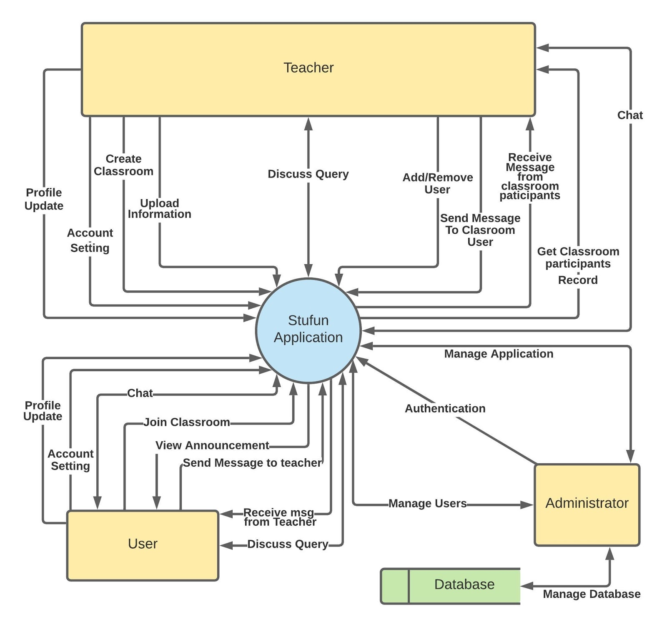
Data flow diagram

Slide 11
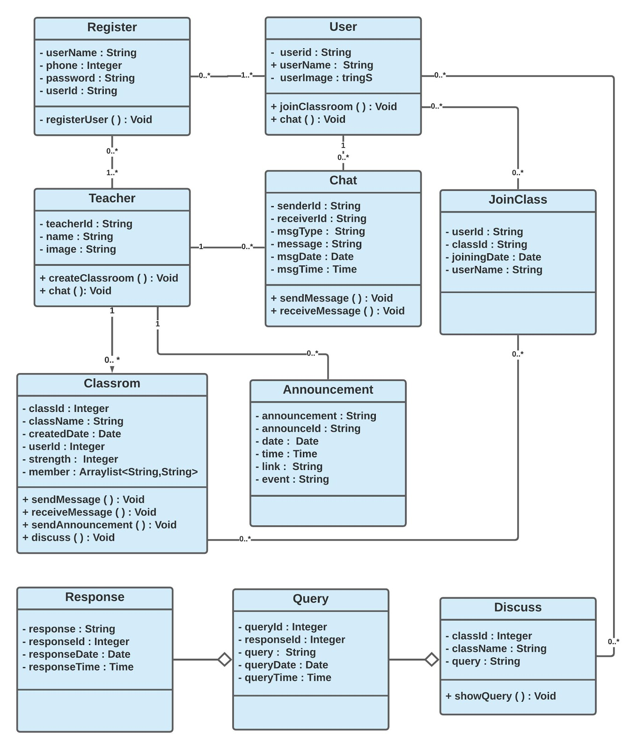
Class diagram

Slide 12
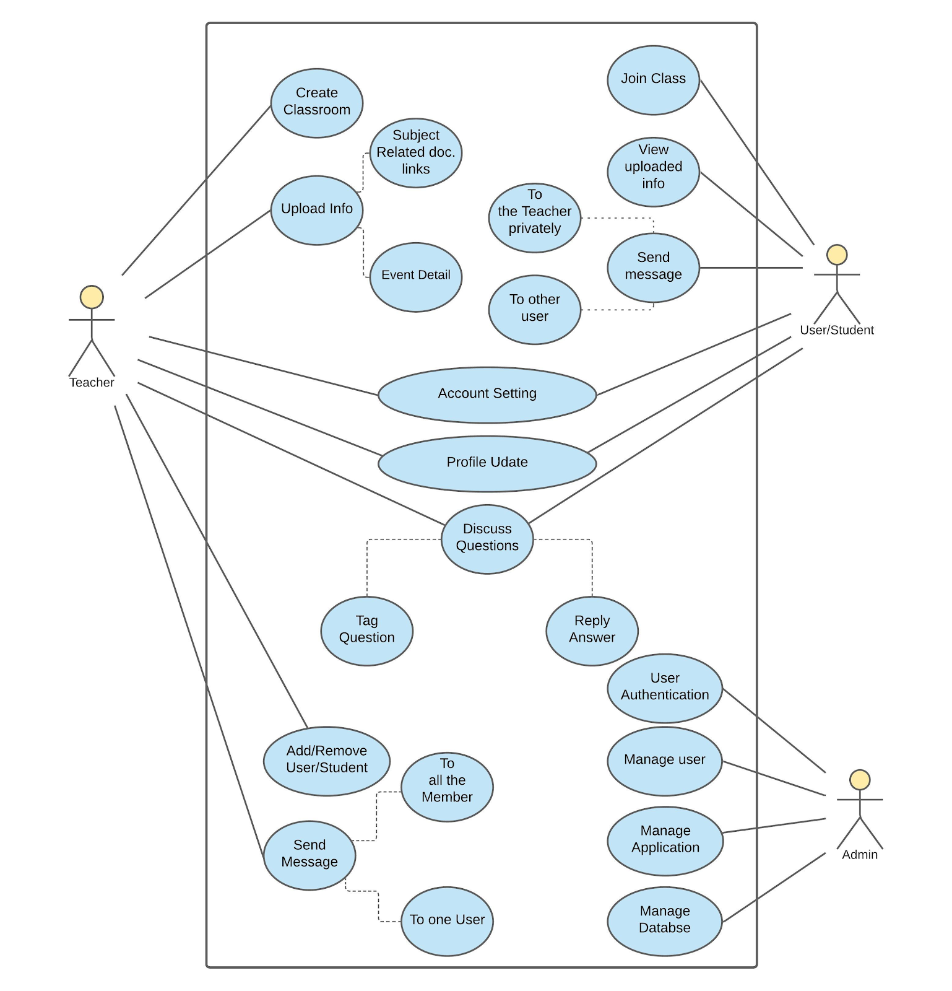
Use case diagram

Slide 13
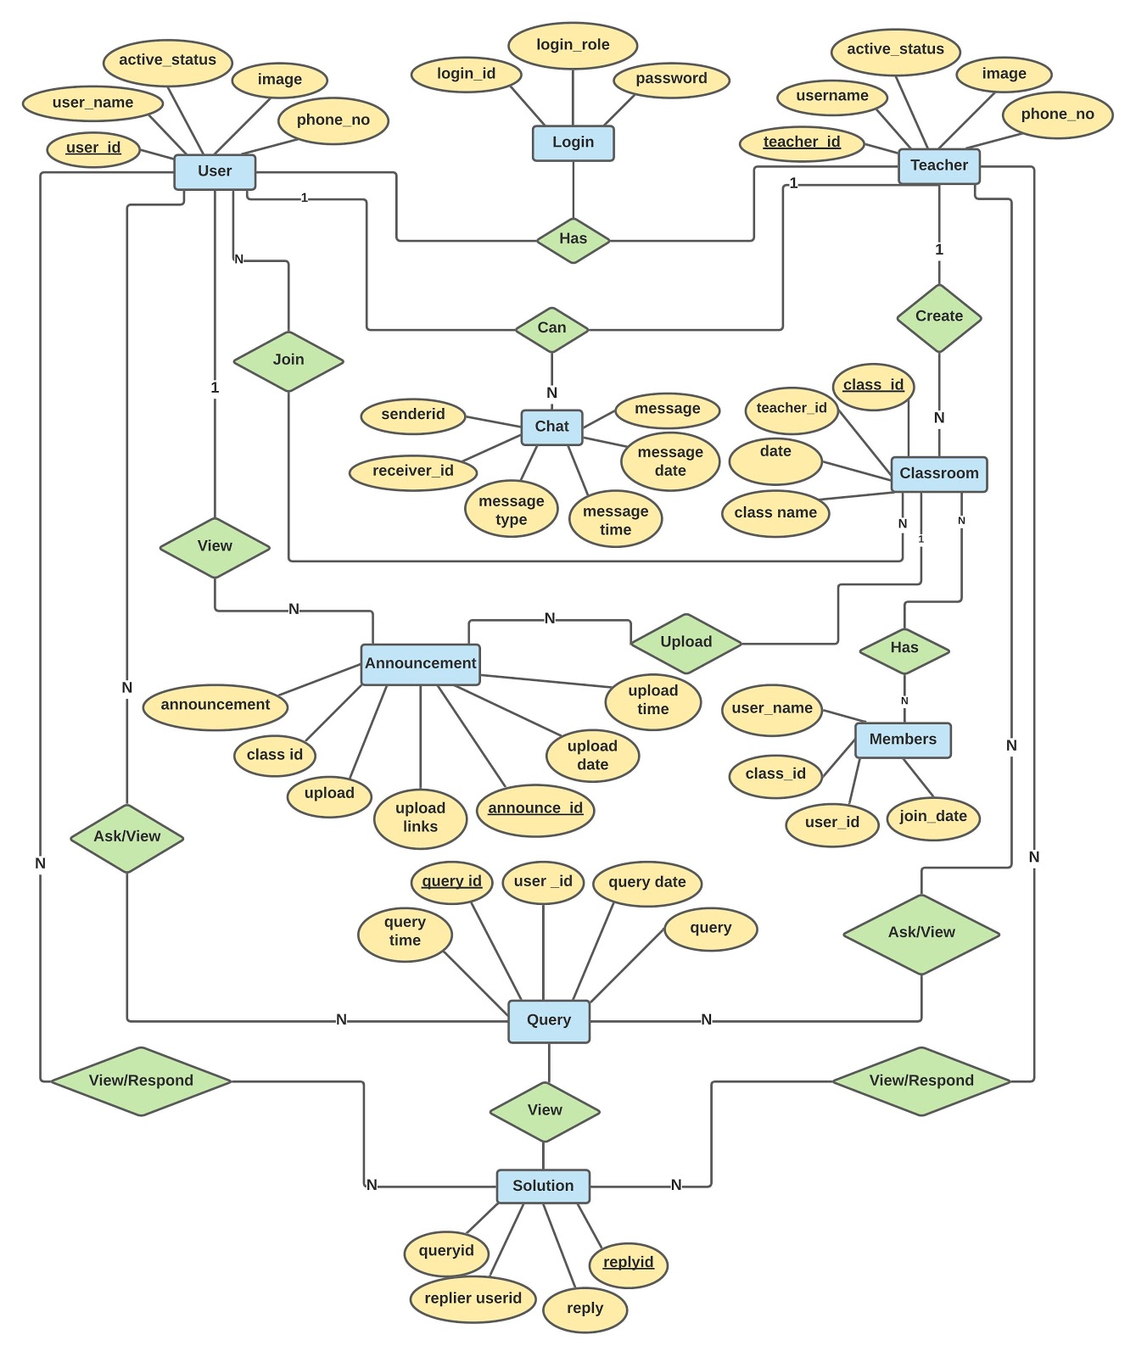
er diagram

Slide 14
Database description
Announcement table
id | String
text | String
Classes
image | String
name | String
uid | String
Discussion
answer | String
question | String
time | String

Slide 15
Database description
UserChat
clear | String
date | String
image | String
isseen | Boolean
message | String
receiver | String
sender | String
type | String
Student Class
classcode | String
classcolorcode | int
classimage | int
classname | String
classsubject | String
datecreated | String
teachername | String
Users
email | String
image | String
name | String
organization | String
type | String
uid | String

Slide 16
Application screenshorts

Slide 17
Add a Slide Title - 2

Slide 18
Add a Slide Title - 4

Slide 19
Add a Slide Title - 5

